Slide 1

IBM Attrition dataset
Introduction to Data Science - Spring 2023
Anne Cuzeau - Andrew Nguyen - Eric Vandament

Slide 2

What makes IBM employees quit?
…is it just about pay?
Notes:
Problem statement

Slide 3
Table of content
1
2
3
4
About our data
Are pay rate and an employee's attrition related?
What makes an employee likely to quit their job?
The Team:
Anne Cuzeau
Andrew Nguyen
Eric Vandament
Conclusion

Slide 4
About
our data
Hypothetical dataset created by IBM data scientists (Kaggle). Very few NaN
BUT: once the employeeID removed: duplicates!
This dataset has 23,436 rows and 37 columns describing different employees profiles
Both numeric and categorical variables
Main goal: find a model to help HR predict attrition and understand how pay rate influences employee retention
Notes:
Anne

Slide 5
Variables
Job related: Job role, Department, job level, travel frequency
Demographics: Age, Gender, Distance from home, relationship status, educational background
Career Descriptions: Number of companies worked for, years at company, years in current role, years since last promotion
Pay: Daily Rate, Hourly Rate, Monthly Income, Monthly Rate
Notes:
Eric

Slide 6
Does pay rate influence attrition?
… or is it influenced by other factors?

Slide 7
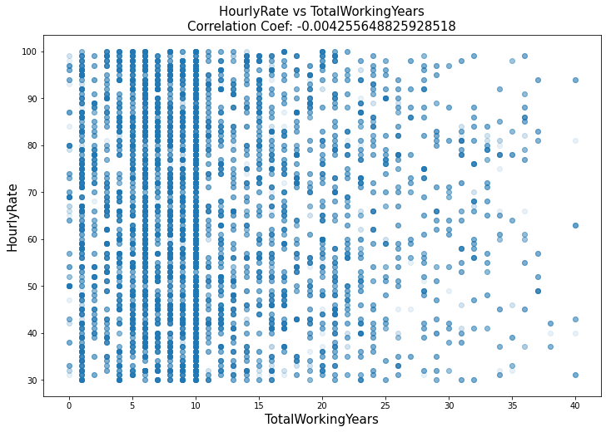
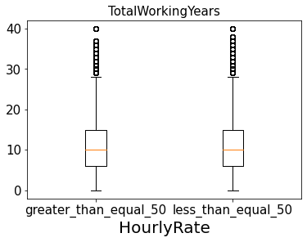
What factors influence pay rate?
Comparing pay rate to other factors, most of the correlation Coefficients are below .1
Notes:
Boxplots, scatterplots, initial findings

Slide 8
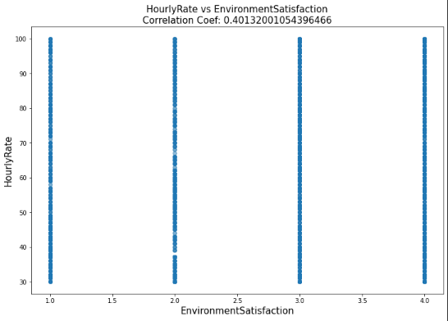
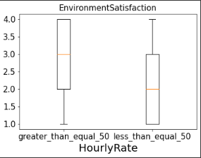
What factors influence pay rate?
With the highest being .4 with Environment Satisfaction
Notes:
Boxplots, scatterplots, initial findings

Slide 9
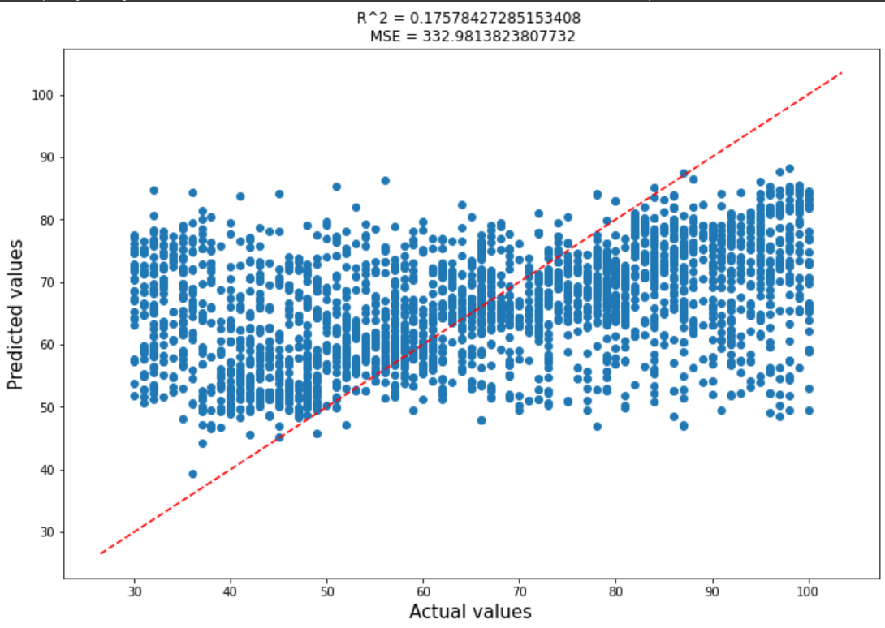
What factors influence pay rate?
Linear Regression Model
Fitting Hourly Rate shows us no real correlation
Notes:
Nearest neighbor

Slide 10
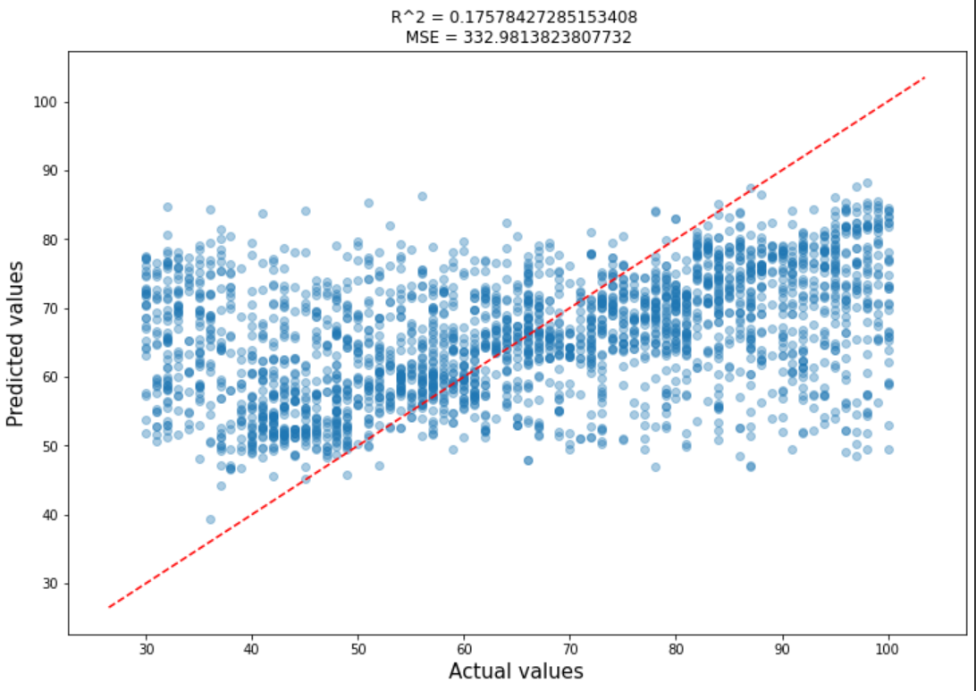
What factors influence pay rate?
Linear Regression Model
Fitting Hourly Rate and using an alpha of 0.375 shows a slight upwards trend but not highly noticeable.
Notes:
Nearest neighbor

Slide 11
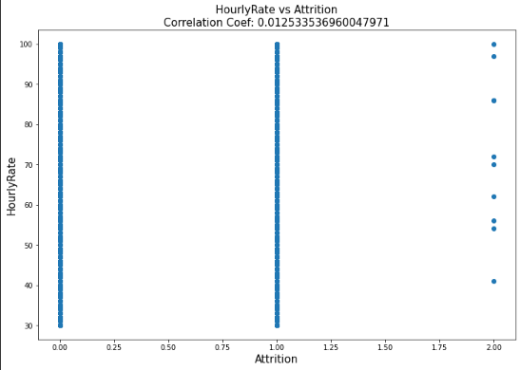
Hourly Rate Vs Attrition
LR model for attrition relies heavily on Monthly and daily rate

Slide 12
Predicting Attrition
What makes an employee likely to quit their job that isn’t pay rate?

Slide 13
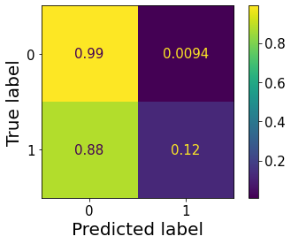
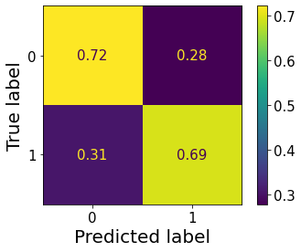
What makes an employee likely to quit their job?
Initial findings, LR baseline
Really good at predicting staying even if they left
LR Confusion Matrix after Balancing Data
Worse at predicting people who will stay
57% increase at predicting people who will leave
Notes:
Eric: talk about balancing, Without balanced data it just predicts people who stay, which isn’t what we want, trying to predict people leaving, equal number of people who stayed and left

Slide 14
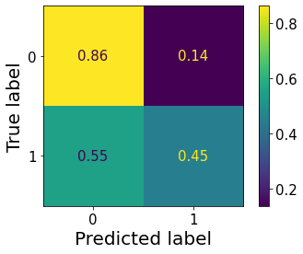
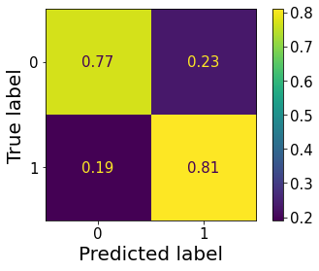
What makes an employee likely to quit their job?
Initial Decision tree and its Confusion Matrix
It is decent at predicting if someone will stay
Terrible at predicting those who left
Depth = 5 Split = 10 Leaf = 5
Decision tree and its Confusion Matrix after Tuning
Decrease of 9% for predicting employees that stayed
Increase of 36% for predicting employees that left
Depth = 30 Split = 5 Leaf = 2
Notes:
Eric - Some of the questions the tree asked: Number of working years less than 5.5, age less than 33.5, Years with current manager less than 1,

Slide 15
Nearest Neighbor
Used gridSearchCV to find the best parameters
Combined high attrition demographics
Combined high attrition roles & levels
KNN with winning metric: Hamming
Ran with stratified data and balanced data
Nearest neighbor: 1

Slide 16
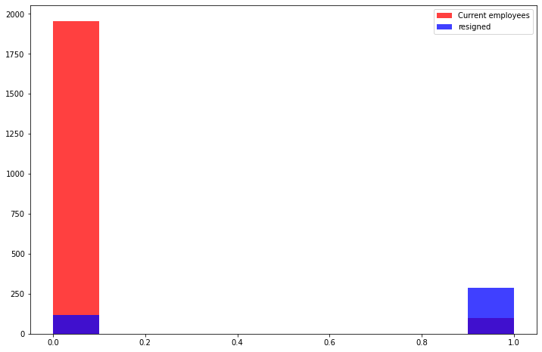
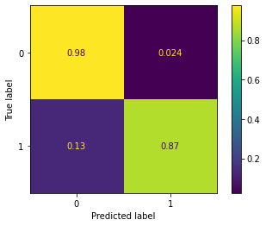
Strong results
Hamming, 1 neighbour, stratified data: 89% overall accuracy

Slide 17
Strong results
Looking at ‘false stayed’:
Very confused about R&D (61% of wrong predictions): diverse job levels, diverse pay. Somewhat higher attrition across job levels
Sales: wrongly predicted that executives would quit
Strong confidence
Even with new columns (broke down R&D by job levels + pay): no improvements

Slide 18
XGBoost
Ran two DTs:
One with stratified data
One with balanced data (number of employees who left = number of employees who stayed)

Slide 19
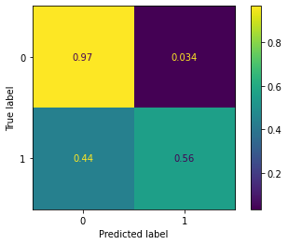
XGBoost: Stratified data
Great at predicting if an employee will stay
Only 56% for predicting if they will quit
Still confused about R&D (56% of the wrong predictions)
Not predicting that everyone will stay: 20% of people predicted to quit

Slide 20
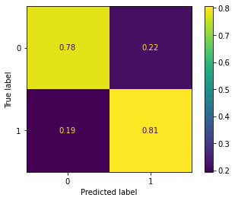
XGBoost: Balanced data
Better at predicting if people will quit
Very small dataset: only training on 1,875 rows
Still confused about R&D: job that were wrongly predicted were mostly - in life science (R&D) - high job levels, except for lab techs.

Slide 21
Main Takeaways

Slide 22
What makes an employee likely to quit their job?
Our Findings:
Entry level employees: Of all job roles the majority of employees leaving are level 1 or 2
Best models: decision trees compared to any other model
People younger in age
Some high attrition roles & levels For instance:
Sales level 1 = 96% quit
Sales Representatives and Laboratory Technicians (46.33% of people who quit)
Notes:
Eric

Slide 23
Thank you!
Any questions?

Slide 24
Extra Slides

Slide 25
Main takeaways
All models look at the same factors:
Pay rate and attrition are related!
But job role, job levels: huge influences

Slide 26
Next steps
Ditch KNN
Fine-tune our decision tree and logistic regression models
Focus on combining factors:
High & low attrition job level and job role
Look into demographics (marital status, age…)
Look into job environment (satisfaction, distance from home…)
…and of course: pay rate!

Slide 27
Next steps
Try KNN and Logistic Regression (with hyperparameters)?
Focus on combining factors:
Look into demographics (marital status, age…)
Look into job environment (satisfaction, distance from home…)
…and of course: attrition!
Ensembling

Slide 28
Are pay rate and an employee's attrition related?
Tying it all together

Slide 29
Hourly Rate Vs Attrition
LR model for attrition relies heavily on Monthly and daily rate

Slide 30
Are pay rate and an employee's attrition related?
So far: no clear linear relationship
However: our linear regression, Knn and decision tree for attrition rely heavily on:
Pay rate
Job level (related to pay rate)

Slide 31
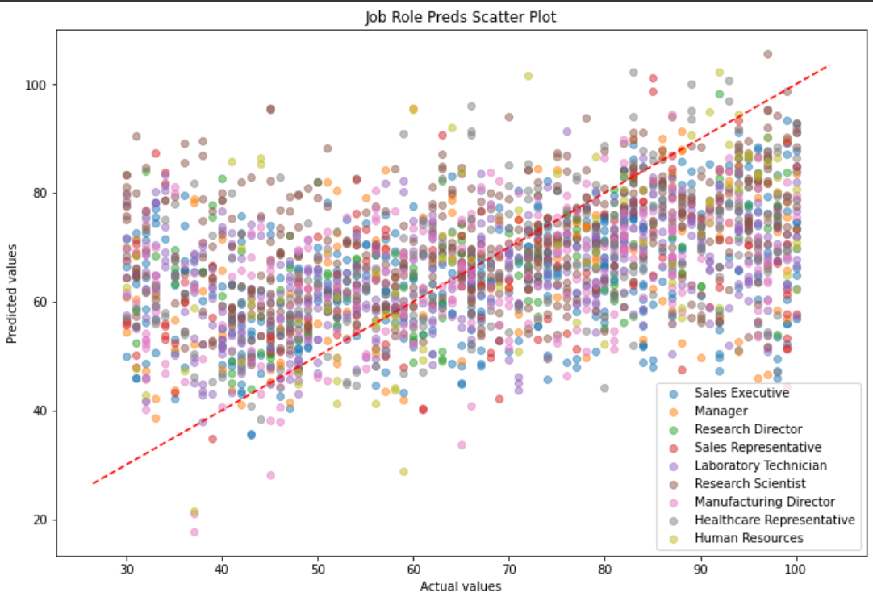

Slide 32
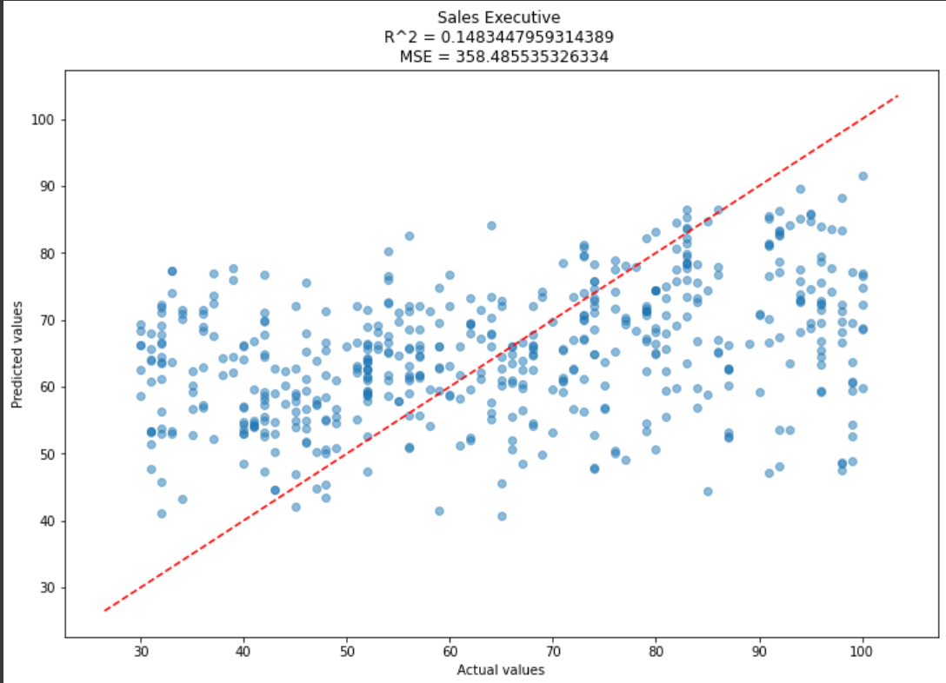

Slide 33
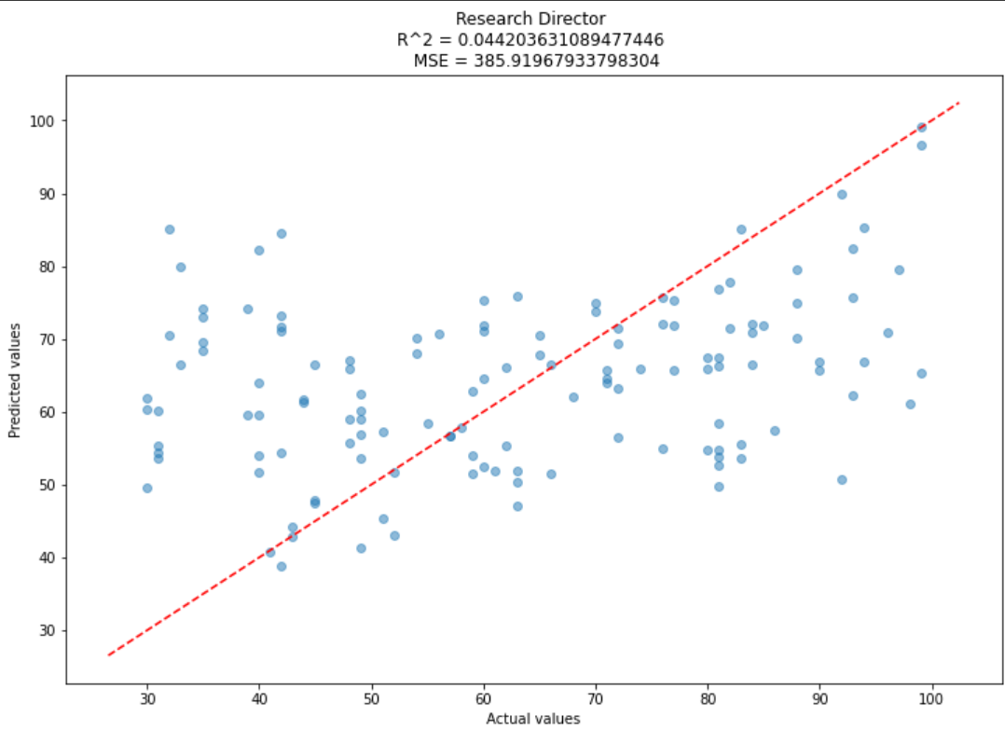
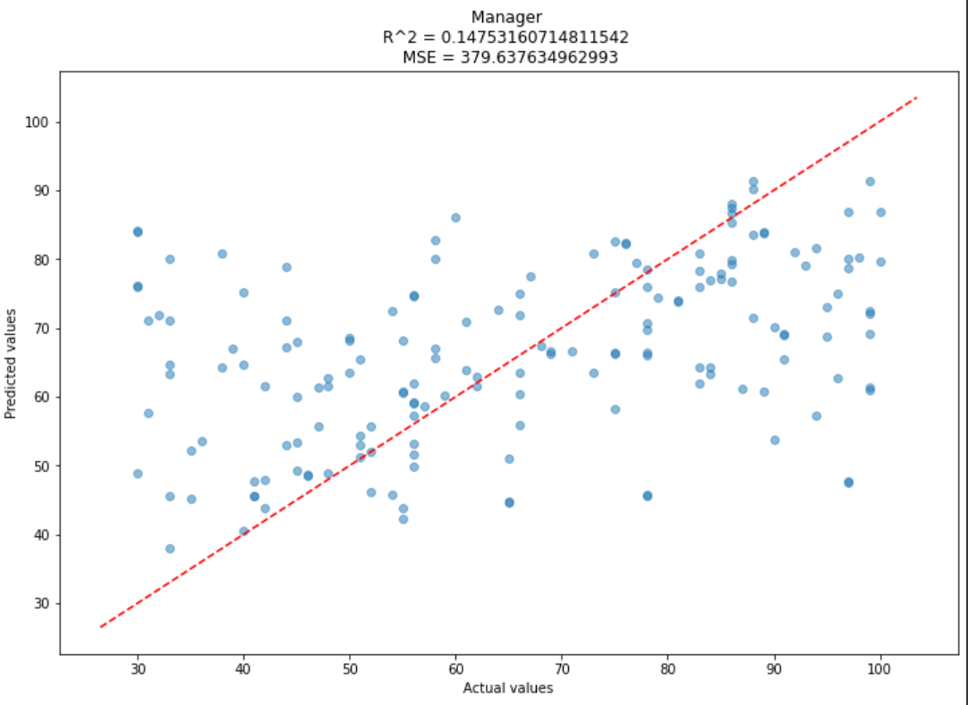

Slide 34
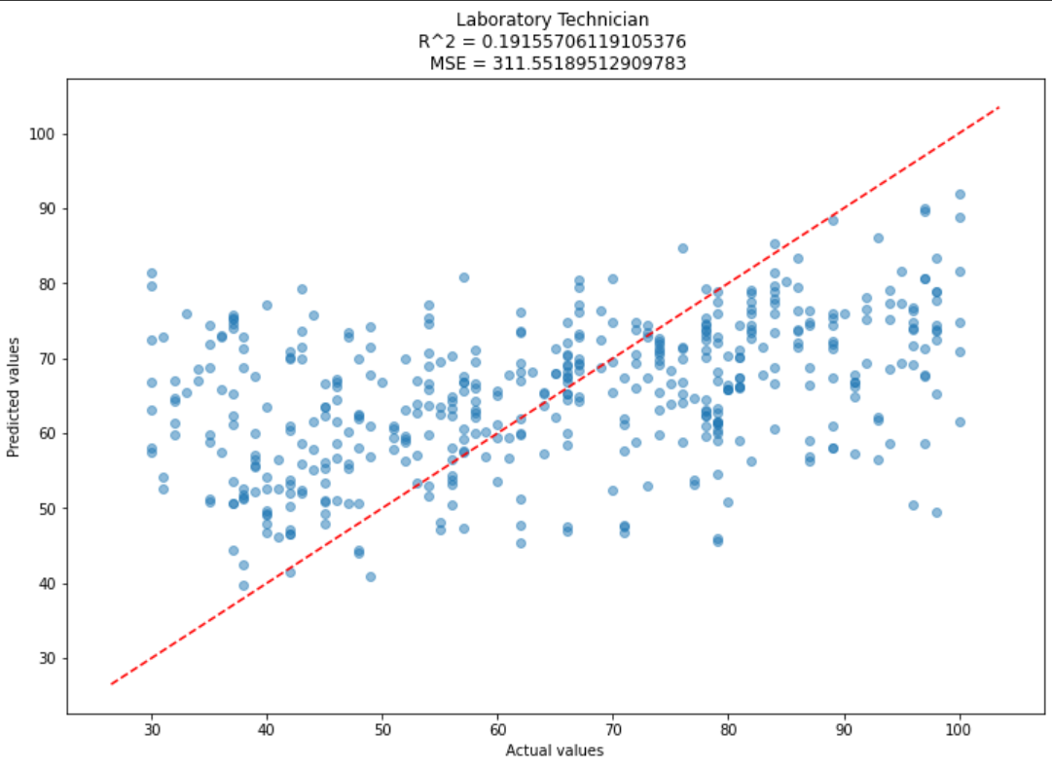
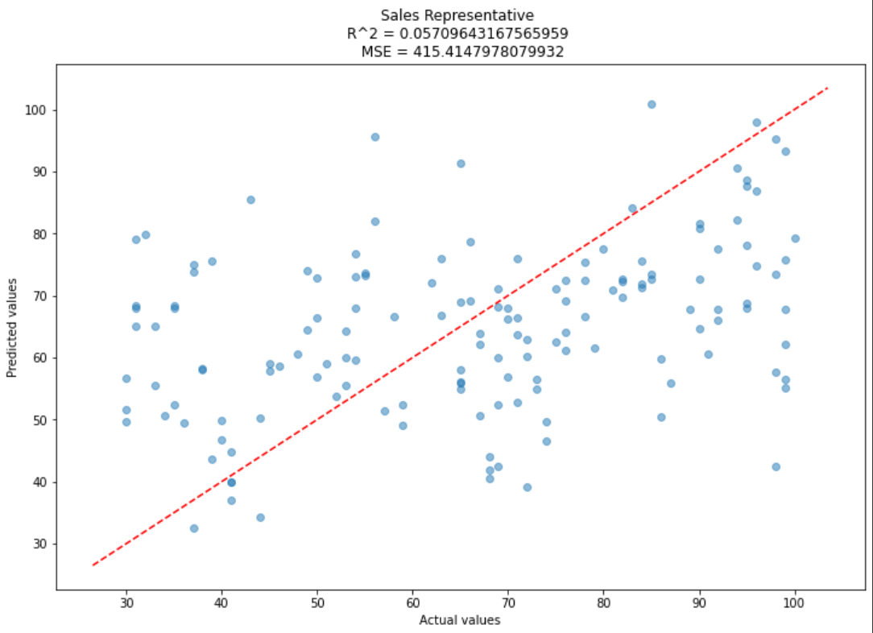

Slide 35
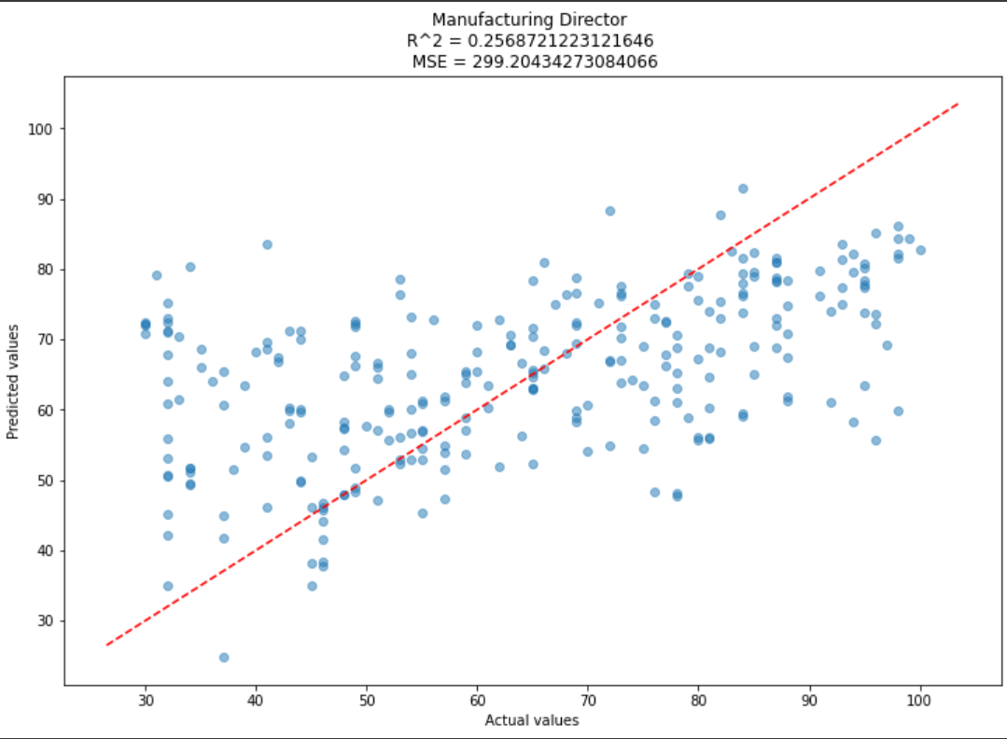
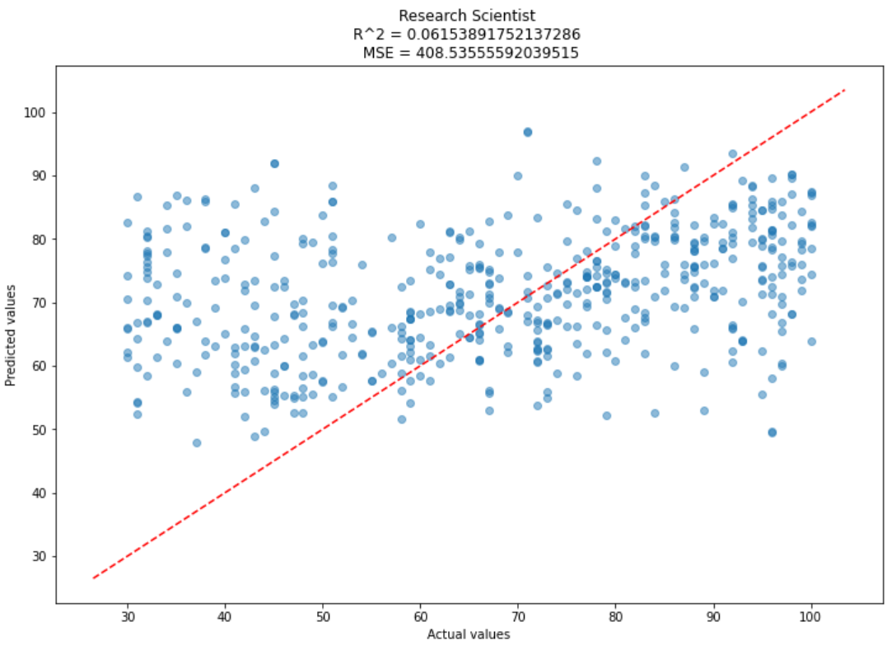

Slide 36
